Slide 1

Business Modeling and Optimization
Team – 7
Sreekar Bathula
Ejiofor Chukwuelue
Piyush Kumar
Bartolomeo Magnani
Magda Albino Useche
This Photo by Unknown author is licensed under CC BY-SA-NC.

Slide 2

Intel Asia-Pacific
The Catch & Win Campaign

Slide 3
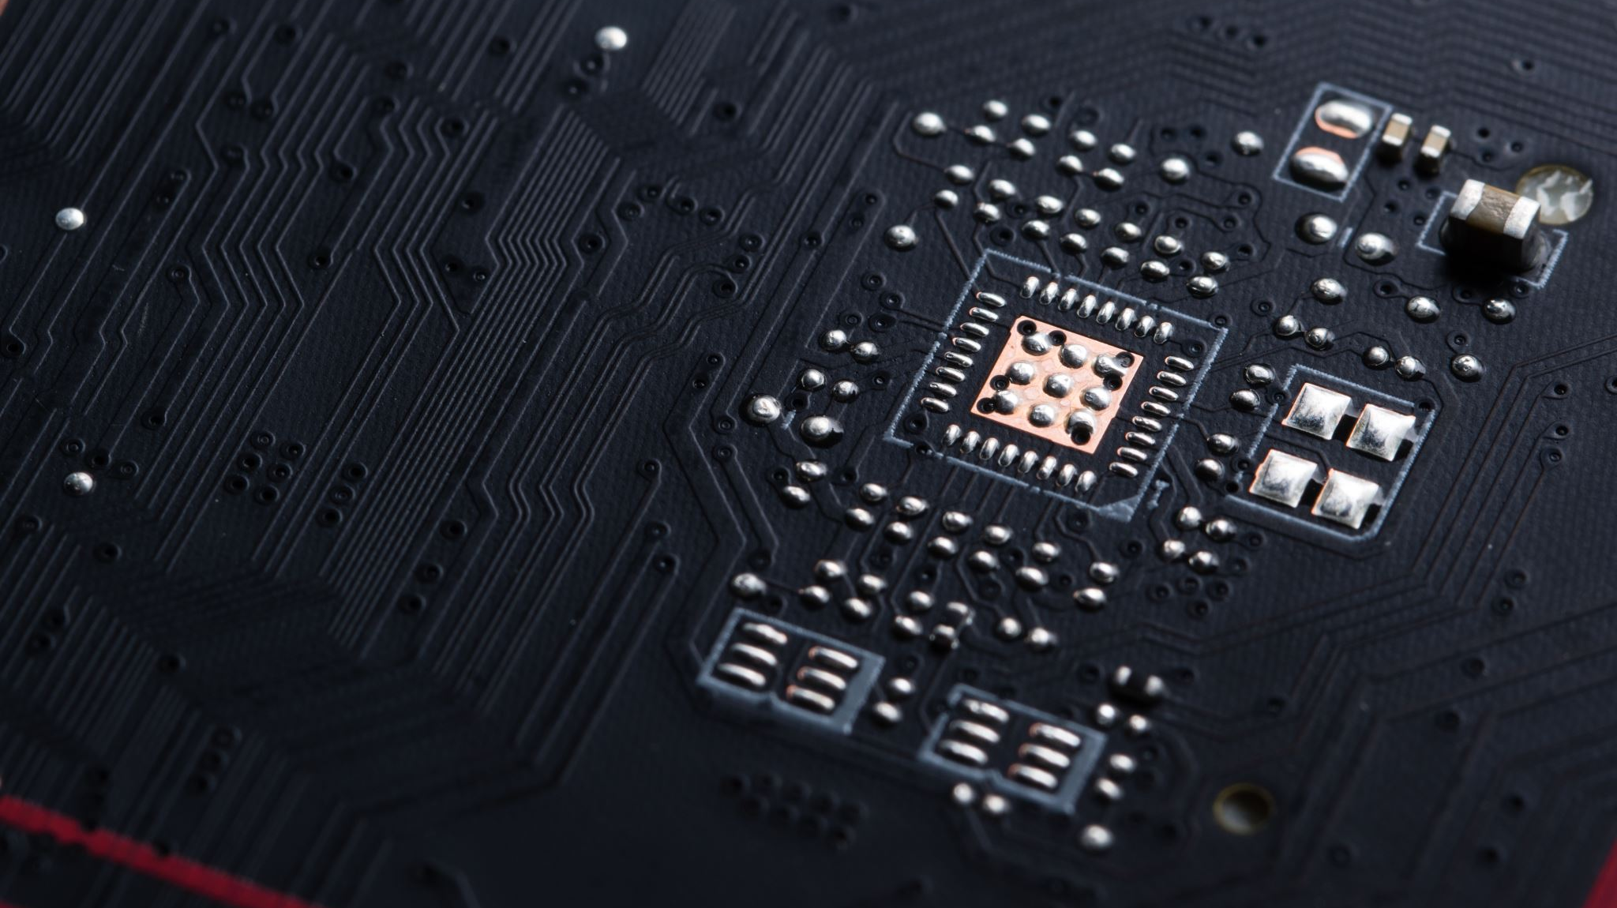
Intel Inside
Company
Intel
Head quarter – Santa Clara
Founded
1968
1st Micro Processor - 1971
Revenue
$50 Billion in 2011
Employees
80,000
Founder
One of the founder Gordon Moore
Head of Data marketing analytics & Mobile
Peter Dingle
Manager of retail marketing
Paula Jones

Slide 4

Introduction
Goal
Showcase powerful & efficient feature to Pc's with intel components and enabling self staff to understand the customer needs.
Aim
Create & execute campaign that delivered measurable retail visits.
Focus
Marketing efforts due to Intel's Indirect relationship with end customers.
Law
Predicted that computing technology would double in power & density per unit volume approximately over 2 years – Moore’s Law

Slide 5

The Catch & Win Marketing Campaign
Promote
Ultrabook laptops
Objective
Create awareness and increase demand for sales of Intel Inside Technology.
Aim
Majorly innovation in personal computer and increase relationships with customer & retail partners.
Target
Smartphone holder in Asia pacific Region.
Competition
Qualcomm

Slide 6

Campaign Strategy
Have a Smart phone and data plan
Member of App store
Discover the contest
Download and install catch & win App
Register with personal details
Visit a participating retailer to play the game.
Top 10 local participant, they would give entry into the competition and top players will win ultra book.
150 ultra books as prize in 8 weeks program.

Slide 7

Advertisement Program
Spent
$ 95000
Generate interest
Maximize the downloads
Objective
Wide exposure of app
Measure
Increase number of add impressions.
Goal
Increase visit to retailers.
achieve high number of clicks through adds.
Promote awareness
Gather feedback.
Uplift of features and functions.
Operations
Consumer awareness and actions are directly influenced by the number of advertising impressions.

Slide 8

Social Marketing in Facebook Marketing
Targeting countries
Indonesia, South Korea, Malaysia, Pakistan, the Philippines and Singapore.
Targeting
Emerging markets relied heavily on the opinions of social connections with peers, friends and family for buying decisions.
Facebook
Facebook's traditional computer-browser interface included two types of placement: Marketplace Ads and Premium Ads.
Demand
The demand for touchscreen phones to run complex applications was growing fast, and quickly becoming the best way to reach consumers.
Conclusion
Users of mobile phones were the prime targets for the Ultrabook, and hence the advertising target for Intel's Catch & Win campaign.
This Photo by Unknown author is licensed under CC BY-SA-NC.

Slide 9

Facebook
Subscriptions
Targeting reach
100 million
CPM
Standard marketting ads - $0.40 and $0.75
1 Billion
Premium ads - $3 and $4
Mobile ads
Aim
Intel remained data-driven, aiming to optimize ad placements and measure results across Ads maintaining a balanced allocation of funds.
Summary
Over 60% of facebook accessed through mobile.
Intel aimed to maximize impressions and click-throughs, considering market conditions and leveraging the effectiveness of different Facebook ad formats, while remaining data-driven in planning and measuring their advertising program.
This Photo by Unknown author is licensed under CC BY-NC.

Slide 10
Original Media Purchase Plan
Impact Marketing Ltd. and Media Purchase Plan
Media Buying Options
Pricing Considerations
The plan assumed different click-through rates (CTRs) for various types of Facebook ads.
CTRs were used to estimate projected clicks.
The chosen plan was based on impressions, where ads would be shown a certain number of times.
Alternatively, Intel could have chosen a cost-per-click model, where ads would be displayed until a desired number of clicks was achieved.
The cost-per-click model would come at a higher unit cost but offer a specific outcome.
Pricing for the cost-per-click model would need to be negotiated.
It would likely be higher compared to the more common cost-per-impression model.
Cost-per-click pricing ensures a guaranteed number of clicks but at a higher cost.
The cost-per-impression model offers broader exposure but without a specific click guarantee.

Slide 11
Facebook Advertising Metrics
- Initial conservative estimate for Mobile Ad CTRs due to lack of empirical data.
- Intel's Asia-Pacific team created country-specific Intel Facebook pages for direct social engagement with users.
- They tracked metrics to measure reach and engagement of posts on these pages.
- Estimates of click-through rates (CTRs) were developed for Marketplace and Premium Ad placements.
- Premium Ads in the News Feed had higher CTRs compared to ads on the right-hand side.
- Premium Ads generated additional earned media impressions and had higher CTRs for these impressions.
- Metrics for Marketplace and Premium CTRs, social impression multipliers, and social CTRs are summarized in Exhibit 5.

Slide 12

Media Buying problem
Initial media purchase plan of $95,000 did not include agency fee of 9%
Need to scale back plan to account for the fee
Metrics can help make selective decisions for optimal results
Proposal to ensure no ad type/country falls below 75% of proposed impressions
Limit total impressions in each market to no more than 125% of original plan
Analysis needed regarding maximum clicks versus impressions for driving participation in the Catch & Win contest

Slide 13
Analytics of market
As depicted in the chart, there was a significant rise in the demand for mobile phones, surpassing the usage of traditional internet access. Notably, countries like Indonesia and Pakistan had a substantial number of mobile phone users, with a user base of over 100 million individuals. Recognizing this trend, Intel made strategic investments in creating dedicated Facebook communities in the Asia-Pacific region.

Slide 14
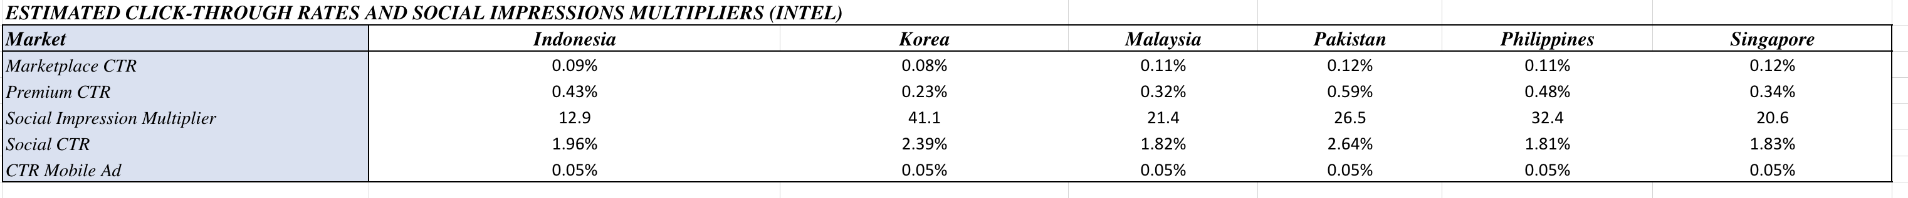
Analytics of market.
Based on Intel's prior experience with Facebook communities in the target countries, the team had formulated estimates for the average Social Impression Multipliers and Social CTRs. It can be inferred that Korea has the potential to achieve higher numbers of impressions and clicks compared to the other candidate countries, based on the values of impression multiplier and CTR.

Slide 15
Problem Statement
Our goal is to maximize overall impressions and clicks by optimizing the media plan for the Catch & Win 2.0 campaign.
The marketing team's objective is to generate consumer interest through a $95,000 campaign budget.
However, the initial media purchase plan did not account for the 9 percent agency fee (Impact Marketing Ltd.), requiring adjustments to accommodate this.

Slide 16
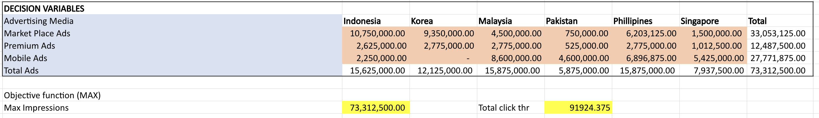
Optimal solution to maximize the number of Impressions.
If the objective coefficient remains within the optimal range, the solution will remain unchanged. The shadow price indicates that increasing the RHS unit will positively impact the objective function.
The optimal solution suggests maximizing impressions to reach a maximum of 73,312,500, resulting in 91,924 click-throughs. Adjustments will be made to the original purchase plan, with Marketplace Ads increasing by 6,053,125 impressions, Premium Ads decreasing by 4,162,500 impressions, and Mobile Ads increasing by 12,771,875 impressions.

Slide 17
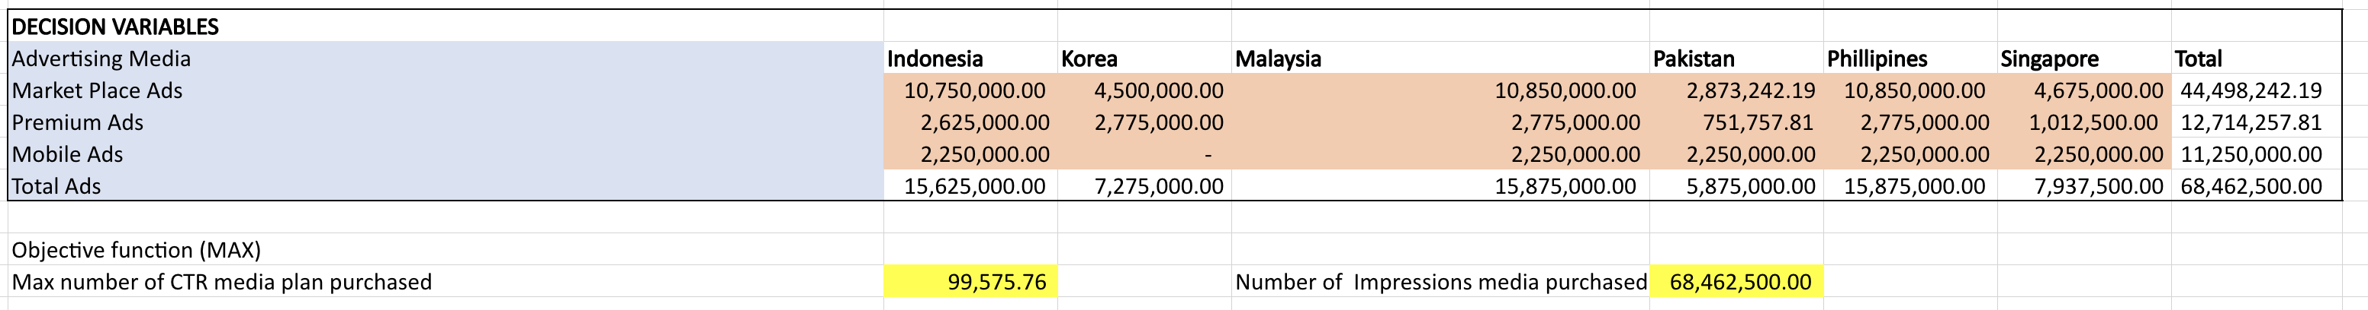
Optimal solution to maximize the number of Click-throughs.
The optimal solution suggests maximizing click-throughs, resulting in a maximum of 99,576.
Adjustments will be made to the original purchase plan, with Marketplace Ads increasing by 17,498,242 impressions, Premium Ads decreasing by 3,935,742 impressions, and Mobile Ads decreasing by 3,750,000 impressions. The total impression will be 68,462,500.

Slide 18
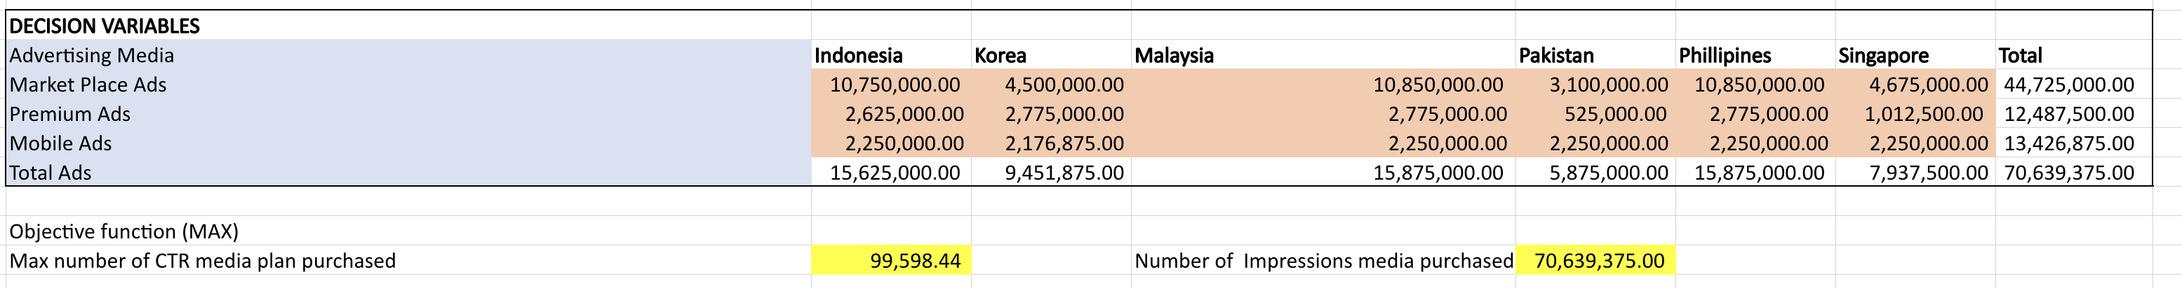
Modified Model
To further increase consumer interest, we will explore the option of investing more in Mobile Ads specifically in Korea.
The optimized solution results in a maximum of 99,598 click-throughs. The total impression increases to 70,639,375, with a reduction in slack by 2,176,875.
By adding a missing constraint, we ensure that no Mobile Ad / Korea combination falls below 75 percent of the originally proposed number of impressions. Assuming a unit cost per 1,000 impressions (CPM) of $0.40 for Mobile Ads in Korea, we aim to utilize the unused capacity in total impressions in Korea.

Slide 19

Recommendations
To maximize the number of impressions, we suggest focusing more on Facebook Marketplace Ads and Mobile Ads, while reducing emphasis on Premium Ads.
To maximize the number of click-throughs, we recommend focusing more on Facebook Marketplace Ads and decreasing emphasis on both Premium Ads and Mobile Ads.
Initially, it is more cost-effective to adopt the Max Impression LP model as a strategic approach to generate interest in the target market. Using click-through rates as a metric at this stage might be premature since the primary goal is to generate initial interest.
For future campaigns, particular attention should be given to Mobile Ads in the Indonesian and Pakistani markets due to the higher number of mobile users compared to internet users. Targeting mobile ads first in these countries would be more cost-effective, considering the growing adoption of mobile devices.
Markets with high Social Impression Multipliers should be prioritized as they offer greater organic reach. These markets provide an opportunity to reach a larger audience in a more organic manner, increasing the likelihood of potential customers clicking on the ads.
It is recommended to invest in additional Mobile Ads in Korea to drive more consumer interest. This can be done without changing the budget constraints and would result in higher numbers of click-throughs and impressions compared to the Max Click-throughs LP model.

